Slide 1

You will need a email account with Microsoft Passport supported
Create a new Office 365 Tenant
https://developer.microsoft.com/en-us/office/dev-program

Slide 2
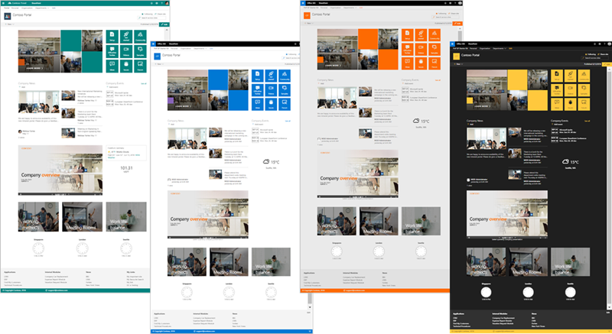
SharePoint Starter Kit
This is an open source solution designed for SharePoint Online which provides numerous web parts, extensions, and other components which you can use as an example and inspiration for your own customizations.

Slide 3

Demostration

Slide 4
Objectives
Automated provisioning of simple demo content within a communication site
Automated provisioning of the whole solution to any tenant within minutes
Automated configuration of Site Scripts and Site Designs at the tenant level using the PnP Remote Provisioning engine
Implementation of different customizations for SharePoint Online
Usage of Office UI Fabric and reusable PnP SPFx controls within the customizations

Slide 5
Pre-Requisites
You will need to be a tenant administrator to be able to deploy this solution
Automatic end-to-end provisioning only works with English tenants
Release preferences for your tenant will need to be set as "Targeted release for everyone" option (also known as First Release)
Add used tenant administrator account as Term Store Administrator in the Taxonomy Term Store
The tenant app catalog must have been created (at least 24 hours)

Slide 6


Demonstration
Web Parts
Extensions
Microsoft Graph based web parts
Codebase
Provisioning

Slide 7

Download and Deployment
Apply-PnPProvisioningHierarchy -Path .\starterkit.pnp -Parameters @{"Company"="Contoso";"SiteUrlPrefix"="contoso";"WeatherCity"="San Diego"}

Slide 8
You will need a email account with Microsoft Passport supported
Create a new Office 365 Tenant
https://developer.microsoft.com/en-us/office/dev-program

